Slide 1
Foundations of Data Science & Analytics DSCI 633
Dipkamal Bhusal and Md Tanvirul Alam
Third Year PhD, GCCIS, RIT

Slide 2
Lecture Agenda
Data Science Pipeline

Slide 3
Steps in data science pipeline
Data Collection and Cleaning
Exploratory Data Analysis (EDA)
Data Pre-Processing
Data Splitting
Model Selection
Model Training
Model Evaluation
Hyperparameter Tuning

Slide 4
Data Collection and Cleaning
Data Quality:
- Poor data quality can lead to inaccurate results, flawed insights, and unreliable models.
- Key aspects of data quality include accuracy, completeness, consistency, reliability, and timeliness.

Slide 5
Data Collection and Cleaning
Data Sources:
- Databases: Relational databases (e.g., MySQL, PostgreSQL) and NoSQL databases (e.g., MongoDB).
- APIs (Application Programming Interfaces): Access data from external services and platforms.
- Web Scraping: Extract data from websites and online sources.
- External files: Local files in formats like CSV, JSON, Excel, etc.

Slide 6
Data Collection and Cleaning
Data Formats:
- CSV (Comma-Separated Values): A text-based format where data is separated by commas or other delimiters. Widely used for tabular data.
- JSON (JavaScript Object Notation): A lightweight data interchange format, suitable for semi-structured and hierarchical data.
- SQL (Structured Query Language): A language for managing and querying relational databases

Slide 7
Data Collection and Cleaning
Data Cleaning:
Handling Missing Data: Missing data can introduce bias and lead to incorrect conclusions. Strategies to handle missing data include: Removing rows with missing values or imputing missing values with a suitable statistic (e.g., mean, median, mode).
Dealing with Duplicates: Duplicate data can skew analysis results.
Managing Outliers: Outliers are extreme values that can distort statistical analysis. Techniques for managing outliers include: - Identifying outliers using statistical methods (e.g., Z-score, IQR). - Deciding whether to remove, transform, or retain outliers based on the project's objectives

Slide 8
Exploratory Data Analysis (EDA)
EDA is a critical initial step in the data science pipeline.
To gain an intuitive understanding of the data and its characteristics.
EDA helps to:
Discover patterns, relationships, and trends in the data.
Identify potential issues or anomalies.
Formulate hypotheses and questions for further analysis.
Determine the appropriate data preprocessing steps.
EDA is often conducted before formal statistical modeling to inform subsequent decisions

Slide 9
Exploratory Data Analysis (EDA): Techniques
Summary Statistics:
Summary statistics provide a snapshot of the data's central tendencies, variability, and distribution.
Key summary statistics include: - Mean, Median, Mode, Variance, Standard Deviation
These statistics offer insights into the data's central location, spread, and shape.

Slide 10
Exploratory Data Analysis (EDA): Techniques
Data Visualization:
Data visualization is a powerful tool for summarizing data and gaining insights.
Visualization techniques include:
Histograms: Visualize the distribution of numerical data.
Box Plots: Display data's spread, median, and outliers.
Scatter Plots: Show relationships between two numerical variables.
Bar Charts: Compare categories or groups.
Line Charts: Depict trends over time or continuous variables.
Heatmaps: Visualize relationships and correlations in large datasets.
Visualization makes it easier to spot patterns, trends, and outliers in the data.

Slide 11
Data Splitting
Why?
Training-Testing Split: assess a model's performance by training it on one subset and testing it on another. This evaluation helps to estimate how well the model will perform on unseen data.
Cross-Validation: Cross-validation, involving multiple splits and evaluations, provides a more robust estimate of a model's performance, reduces overfitting, and is particularly useful for small datasets.

Slide 12
Data Splitting
Ways to do it
Simple Hold-Out Split Method: A single split of the data into a training and a testing set.
Pros: Simple, quick, suitable for large datasets.
Cons: Limited evaluation, variance in evaluation metrics.
k-Fold Cross-Validation Method: The data is divided into k subsets (folds), and the model is trained and tested k times, with each fold serving as the testing set once.
Pros: Robust evaluation, reduced overfitting, better use of data.
Cons: Computationally expensive, not suitable for real-time applications.
Leave-One-Out Cross-Validation (LOOCV) Method: An extreme form of k-Fold Cross-Validation where k is set to the number of data points. The model is trained and tested on each individual data point.
Pros: Minimal bias, maximum use of data.
Cons: Extremely computationally expensive, can have high variance.

Slide 13
Data Splitting
Practical Considerations
Data Imbalance Consideration: Ensure that the class distribution remains consistent in both training and testing sets, especially when dealing with imbalanced datasets.
Randomness Consideration: Randomly shuffle the dataset before splitting to prevent any inherent ordering from affecting the model's performance.
Data Leakage Consideration: Be cautious to avoid data leakage. Ensure that no information from the testing set is inadvertently used in the training process.
Data Preprocessing Consideration: Apply data preprocessing steps consistently to both the training and testing sets to avoid discrepancies.

Slide 14
Model Selection
Choosing an appropriate machine learning for the given dataset
Factors to consider
Problem type: Whether the problem is a classification, regression, or clustering
Dataset characteristics: Assess the dataset size, dimensionality, linearity, and the presence of categorical or numerical features. Different algorithms perform better with specific dataset characteristics.
Model complexity: Consider the trade-off between model complexity and interpretability. More complex models might provide higher accuracy but can be harder to interpret.
Computational resources: Available computational resources, as some models might require more time and computational power to train.

Slide 15
Model Selection
Algorithms
Classification tasks – Logistic Regression, Decision Trees, Random Forests, Support Vector Machines (SVM), Naive Bayes, Neural Networks
https://scikit-learn.org/stable/supervised_learning.html
Regression tasks – Linear Regression, Ridge Regression, Lasso Regression, and Decision Trees
https://scikit-learn.org/stable/supervised_learning.html
Clustering – K-Means, DBSCAN, and Agglomerative Clustering etc.
https://scikit-learn.org/stable/modules/clustering.html

Slide 16
Model Training
Train specific models on the given dataset
Key steps
Model initialization (parameters or weights)
Iterative optimization (optimize model parameters by minimizing the loss function)
Validation & monitoring (evaluate performance on the validation set to monitor progress and prevent overfitting)
Hyperparameter tuning (fine tune the model hyperparameters using grid search, random search or bayesian optimization)
Training convergence (determine the stopping criterion)

Slide 17
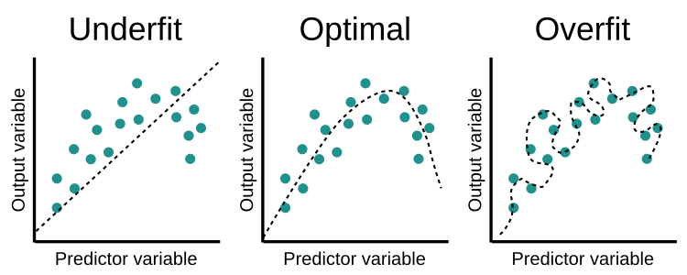
Model Training
Overfitting & Underfitting
Overfitting occurs when the model learns the training data too well and performs poorly on new data. Techniques like regularization, early stopping, or reducing model complexity can help mitigate overfitting.
Underfitting happens when the model is too simple to capture the underlying patterns in the training data. Increasing model complexity or adding more features can address underfitting.

Slide 18
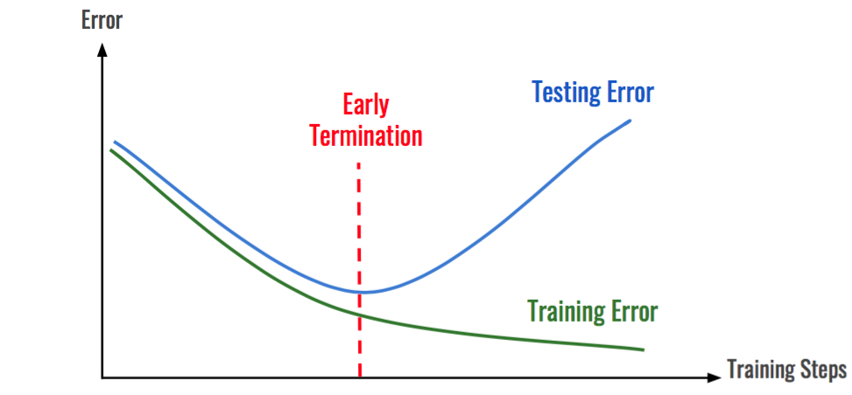
Model Training
Early Stopping
Helps prevent overfitting and improve generalization.
Monitor the model's performance on a separate validation set during training.
Halt the training process is halted if the model's performance on the validation set starts to deteriorate or reaches a plateau.

Slide 19
Model Evaluation
Assess the performance and effectiveness of the trained model on unseen data
Determine how well the model generalizes
Selecting appropriate evaluation metric is important
Reference: https://scikit-learn.org/stable/modules/model_evaluation.html

Slide 20
Model Evaluation
Commonly used metrics
Accuracy: Accuracy measures the proportion of correctly classified instances out of the total number of instances. It is suitable for balanced datasets
Precision: It quantifies the proportion of correctly predicted positive instances out of all instances predicted as positive. Precision is calculated as TP / (TP + FP), where TP is the number of true positives and FP is the number of false positives.
Recall: Recall measures the proportion of correctly predicted positive instances out of all actual positive instances. Recall is calculated as TP / (TP + FN), where FN is the number of false negatives.
F1-Score: The F1-score is the harmonic mean of precision and recall, providing a balanced measure between the two. The F1-score is calculated as 2 * (Precision * Recall) / (Precision + Recall).

Slide 21
Model Evaluation
Commonly used metrics
Mean Squared Error (MSE): MSE is a common evaluation metric for regression problems. It calculates the average squared difference between the predicted and actual values.
Mean Absolute Error (MAE): MAE is another evaluation metric for regression problems. It calculates the average absolute difference between the predicted and actual values.
Receiver Operating Characteristic (ROC) Curve and Area Under the Curve (AUC): ROC curve is a graphical representation of the trade-off between the true positive rate (TPR) and the false positive rate (FPR) at various classification thresholds.
AUC represents the overall performance of a binary classifier by calculating the area under the ROC curve.

Slide 22
Hyperparameter tuning
These are parameters that are not learned from the data but are set by the machine learning practitioner. Example: Number of layers/neurons in neural network.
Hyperparameter tuning aims to find the optimal values for these parameters to improve model performance and generalization.
Repeatedly evaluating performance on the validation set during tuning can lead to overfitting. Use cross-validation or a separate validation set (train/validation/test split) to mitigate this issue.
Can be computationally expensive.
Reference: https://scikit-learn.org/stable/modules/grid_search.html

